Slide 1
Python Mini-Project
​

Slide 2


Agenda
A
About Us
Problem Statement
Technology & Skills
Data Description
Data Dictionary
Questions & Solutions
Data Cleaning
Problem Solving
Conclusion

Slide 3
About Us Team Member’s Name
Shruti Bansal
Anjali Dubey
MD Modassir
Nimisha Khandelwal
Karpagaganesh N
Akshita Gupta

Slide 4
Problem Statement
Loan Dataset is a dataset that contains the complete loan data for all loans issued from the year 2007 to 2011.
The problem statement of this project is mainly to identify risky loan applicants which can be used to identify risks to avoid any financial loss to the company.

Slide 5
Technology and Skills
Skill – Python Programming Language , Exploratory Data Analysis
Technology/IDE – Jupyter Notebook

Slide 6
Data Description
Loan Dataset is a dataset that contains the complete loan data for all loans issued from the year 2007 to 2011.

Slide 7
Data Dictionary
1.Annual_inc - The self-reported annual income provided by the borrower during registration.
2.Dti - A ratio calculated using the borrower’s total monthly debt payments on the total debt obligations, excluding mortgage and the requested LC loan, divided by the borrower’s self-reported monthly income.
3.Emp_length -Employment length in years. Possible values are between 0 and 10 where 0 means less than one year and 10 means ten or more years.
4.Funded_amnt - The total amount committed to that loan at that point in time.
5.Funded_amnt_inv -The total amount committed by investors for that loan at that point in time.
6.grade - LC assigned loan grade
7.id - A unique LC assigned ID for the loan listing.
8.installment - The monthly payment owed by the borrower if the loan originates.
9.int_rate - Interest Rate on the loan
10.last_pymnt_amnt-Last total payment amount received
11.last_pymnt_d -Last month payment was received
12.loan_amnt -The listed amount of the loan applied for by the borrower. If at some point in time, the credit department reduces the loan amount, then it will be reflected in this value.
13.loan_status - Current status of the loan
14.member_id -A unique LC assigned Id for the borrower member.
15.purpose - A category provided by the borrower for the loan request.
16.term -The number of payments on the loan. Values are in months and can be either 36 or 60.
17.total_acc -The total number of credit lines currently in the borrower's credit file
18.total_pymnt -Payments received to date for total amount funded
19.total_pymnt_inv -Payments received to date for portion of total amount funded by investors
20.total_rec_int -Interest received to date
D

Slide 8
Questions & Solutions

Slide 9
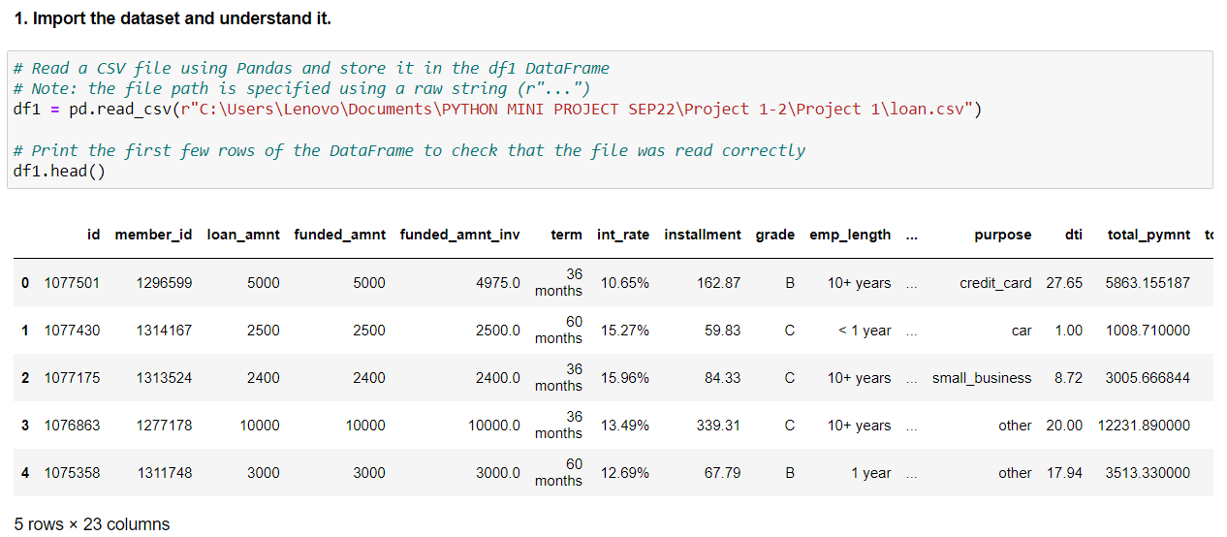

Slide 10
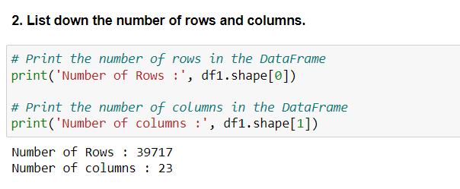
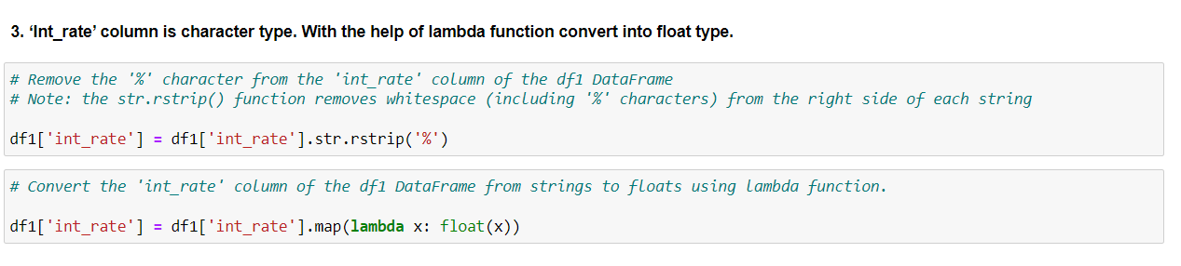

Slide 11
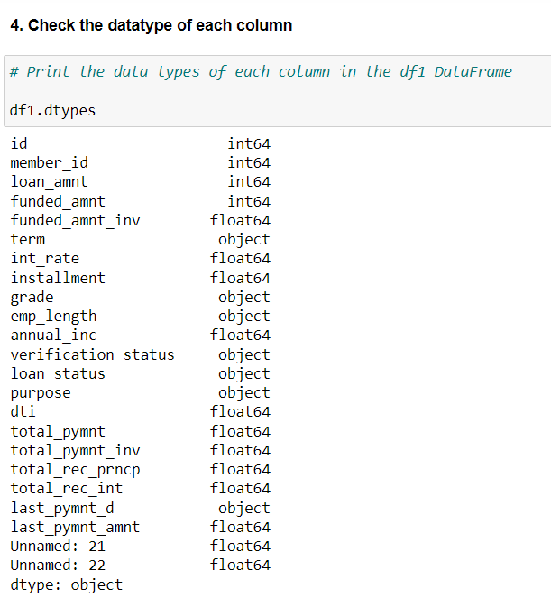

Slide 12
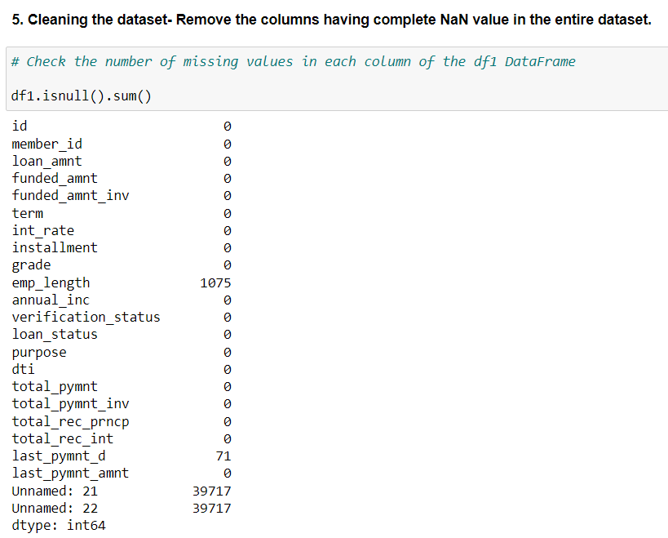
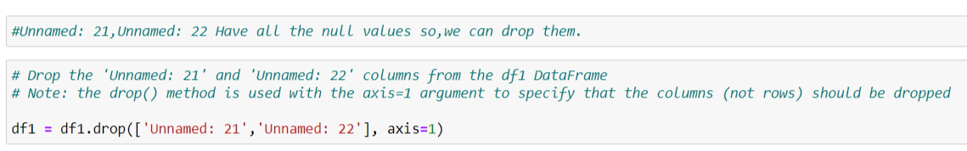

Slide 13
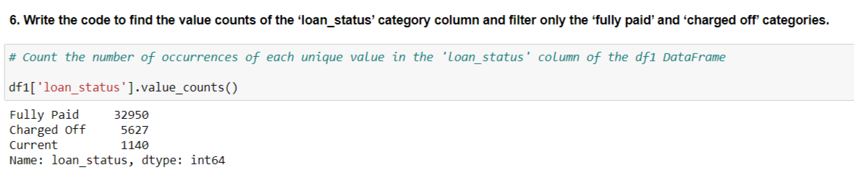
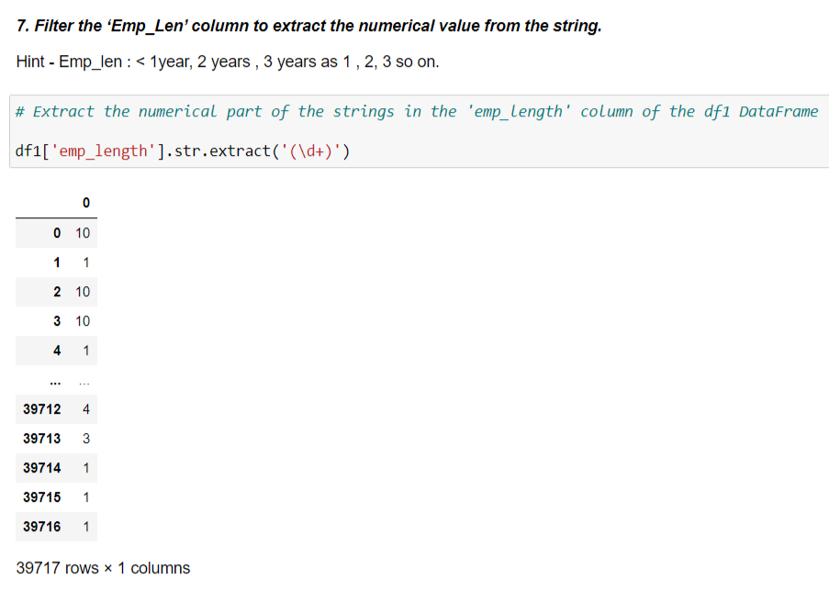

Slide 14
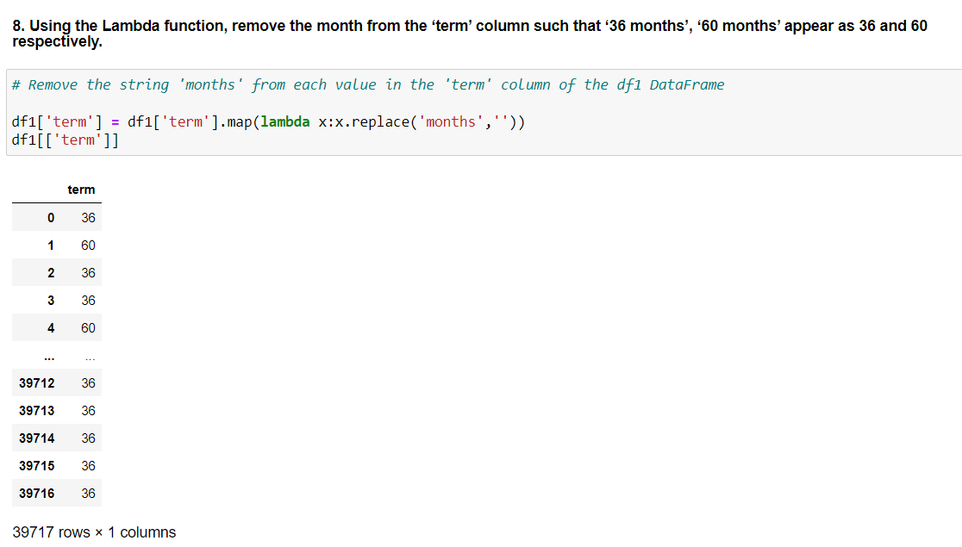

Slide 15
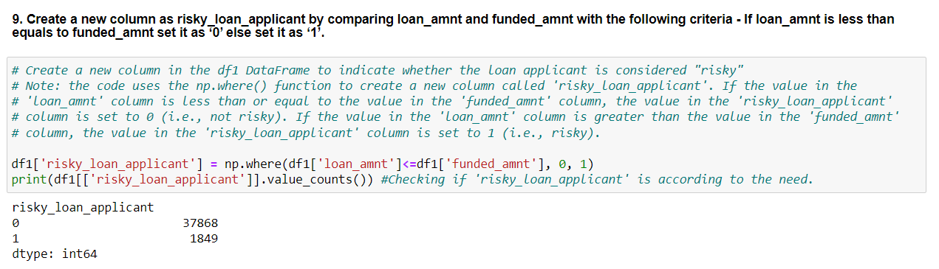

Slide 16
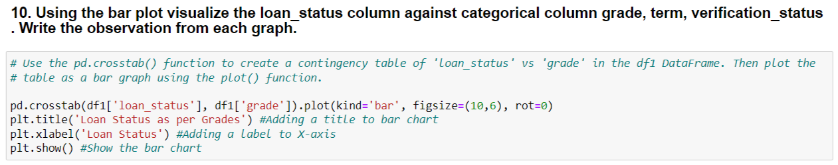
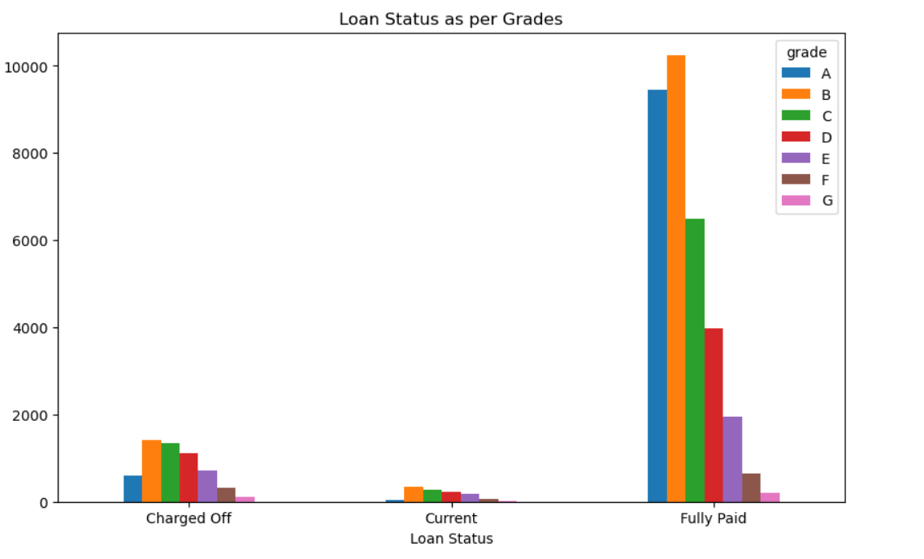

Slide 17
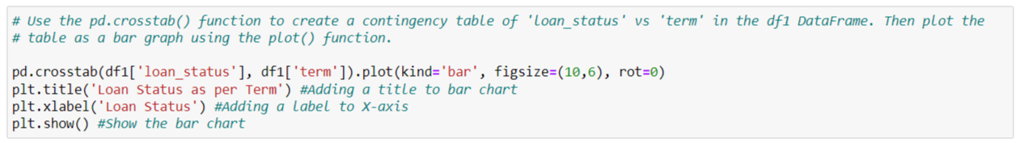
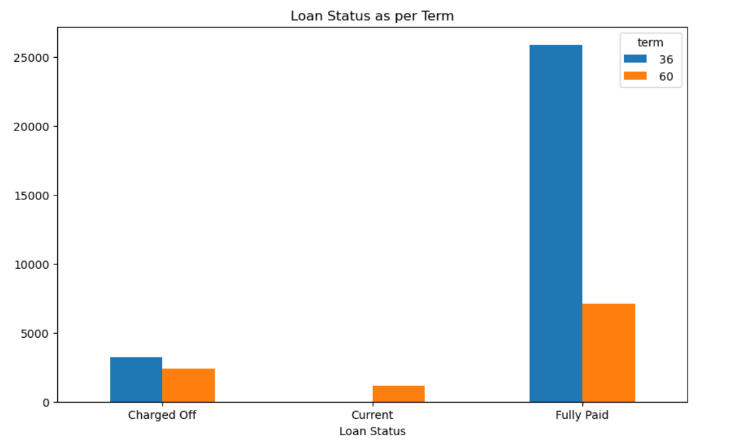

Slide 18
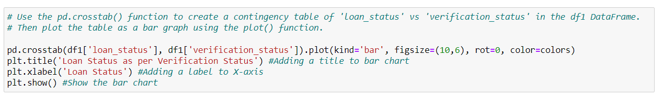
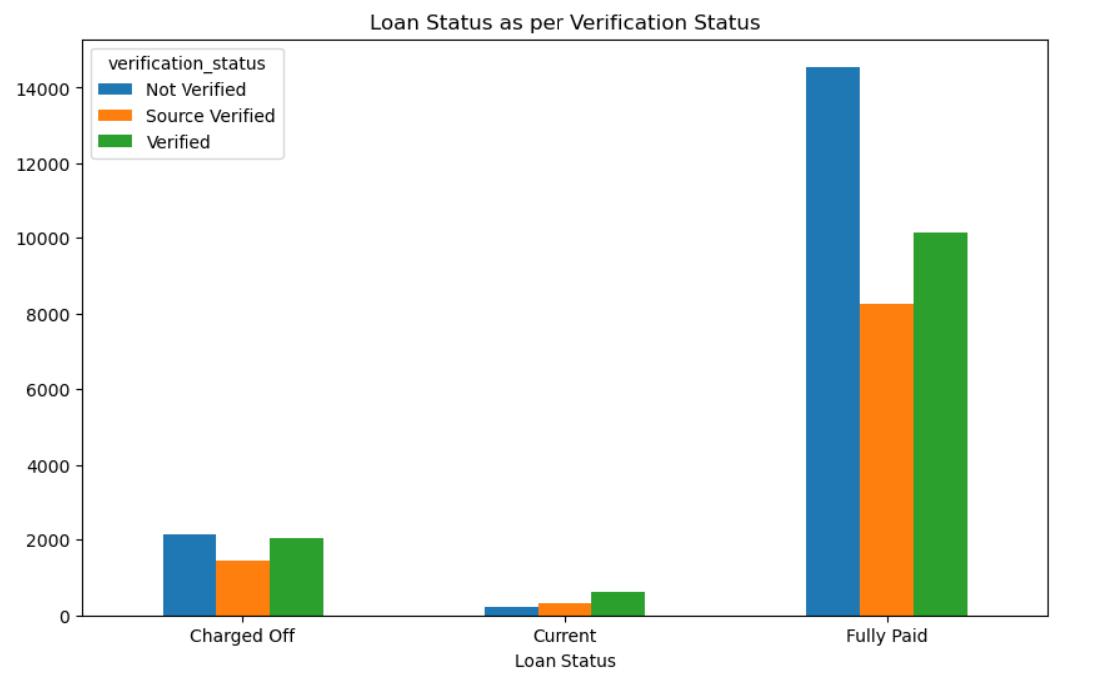

Slide 19
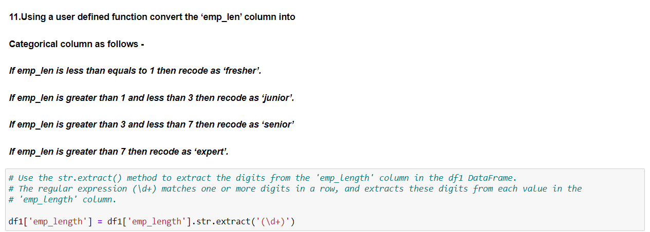

Slide 20
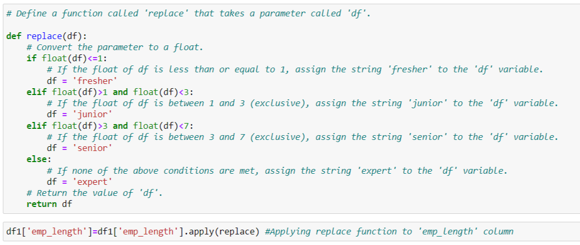

Slide 21
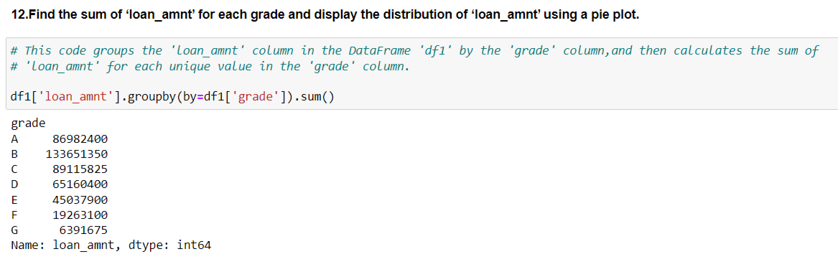

Slide 22
Data Cleaning
In this dataset, we have two columns named Unnamed 21 and Unnamed 22 which contain null values in every row. It does not convey any information So we dropped these two columns.
We also added one column named Risky loan applicant by comparing the Loan amount and Funded amount with this criteria - If the loan amount is less than equal to the funded amount set it as ‘0’ else set it as ‘1’.
We converted the Interest rate column datatype from object to float datatype so in case if we need to do some mathematical operations then we do not face any kind of problem.
We converted the Employee length column into a categorical column into four categories: Expert, Senior, Fresher, and junior.
C

Slide 23
Problem Solving Steps
Data Understanding
Data was not so cleaned so we cleaned the data first and then got to know that the data types of some columns are not appropriate. Also, There were 2 unnecessary columns present.
Data Cleaning and Modelling
We Changed the data type according to the column and Deleted the unnecessary columns. Also, Removed the null values and removed the duplicates.
Identifying Risky loan applicants
Identified Risky loan applicants by comparing loan amount and funded amount.

Slide 24
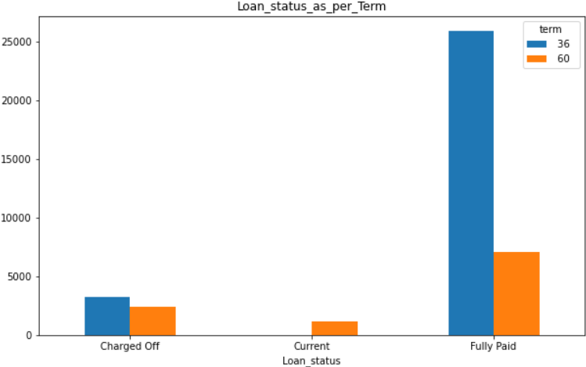
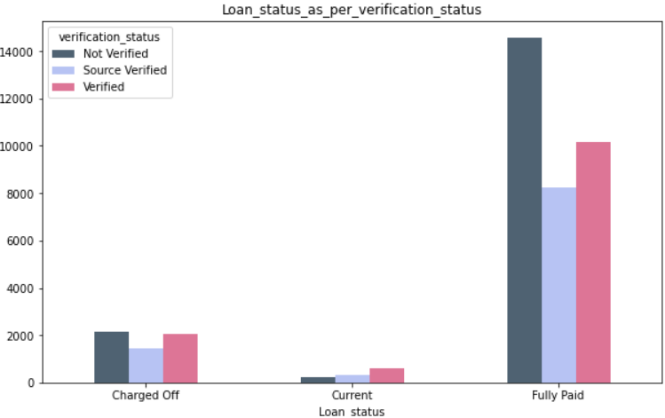
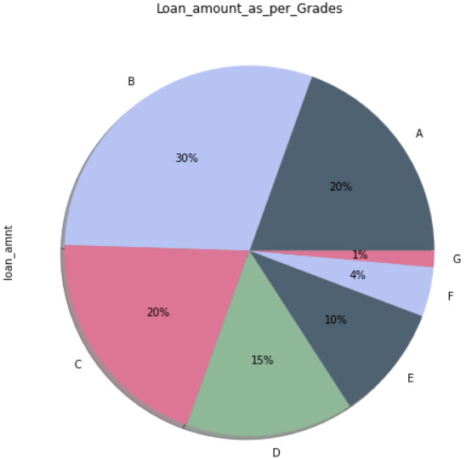
Insights Using Graphs/Charts
This diagram shows that Current loan status has only a 5-year loan duration.
This bar chart states that most of the charged off loans are not-verified whereas most of the current loans are verified.
The pie chart clearly shows that most of the loan amount is of B-Grade followed by C-Grade.

Slide 25
Conclusion
Risky loan column states that nearly 37868 number of loans are risky.
Most of loans are taken by persons who are working more than 7 years and we named them as a Experts.
Most of the loans are Fully paid.
Approximately 29096 people have taken 3-year loans and other than them, About 10621 people have taken loans for 5 years.
Most people have taken B-grade loans followed by A and C-grade loans.

Slide 26
Future Steps
F
The loan company should have a well-defined lending policy that outlines the criteria for approving loans and the procedures for verifying information provided by borrowers. The policy should also specify the loan limits and the types of loans that the loan company can grant.
The loan company should monitor the performance of their borrowers by keeping track of their repayment history, financial statements, and other relevant information. This would help loan company to identify early warning signs of potential default and take appropriate action.
The loan company should set interest rates that reflect the risk of lending to different types of borrowers. This helps to ensure that borrowers who are more likely to default pay higher interest rates, while those with better credit histories pay lower rates.
The loan company can mitigate risks by requiring borrowers to provide collateral to secure loans. This collateral can be in the form of assets such as real estate, inventory, or equipment, which the loan company can seize in the event of default.
The loan company can mitigate risks by analyzing the creditworthiness of borrowers before granting loans. This analysis should involve reviewing the borrower's credit history, income, debt-to-income ratio, and collateral, if any.

Slide 27
Thank you

